Slide 1
DMV Housing Analysis 2021-2023
Group 7: Yonathan Shimelis, Sagar Shah, Dhwanil Mori, Fardin Hafiz

Slide 2

Background Information
Housing prices have steadily increased for years in the US
A hot topic in the current political climate
Wanted to analyze the effects on the local DMV area
From 1992 there is a 4.2% increase in housing prices

Slide 3

Our Dataset
Our dataset is from Zillow(a real estate marketplace that offers a variety of information on homes.)
Zillow is a good reference to see housing prices
We filtered the data by zip code and from 2021-2023
Data is updated on the 12th of each month

Slide 4

SMART Questions
Analyzing the housing price trends in the DMV area between 2021-2023 in order to test the common belief that housing prices are increasing around the area.
How does the average ZHVI of the three areas (D.C., Maryland, Virginia) compare from 2021-2023?

Slide 5
Exploratory Data Analysis

Slide 6
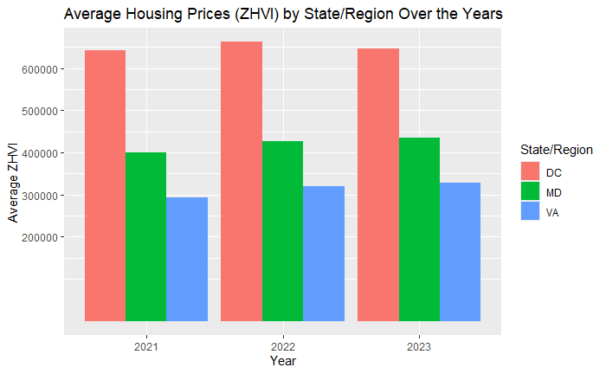
Avg ZHVI by state/region (2021-2023)
Avg housing price in DC wasn’t always increasing
643,242 to 662,298 to 647,048
Virginia was always increasing.
293,828 to 319,719 to 328,925
Maryland is the same with housing going from
400,198 to 426,621 and 434,221

Slide 7
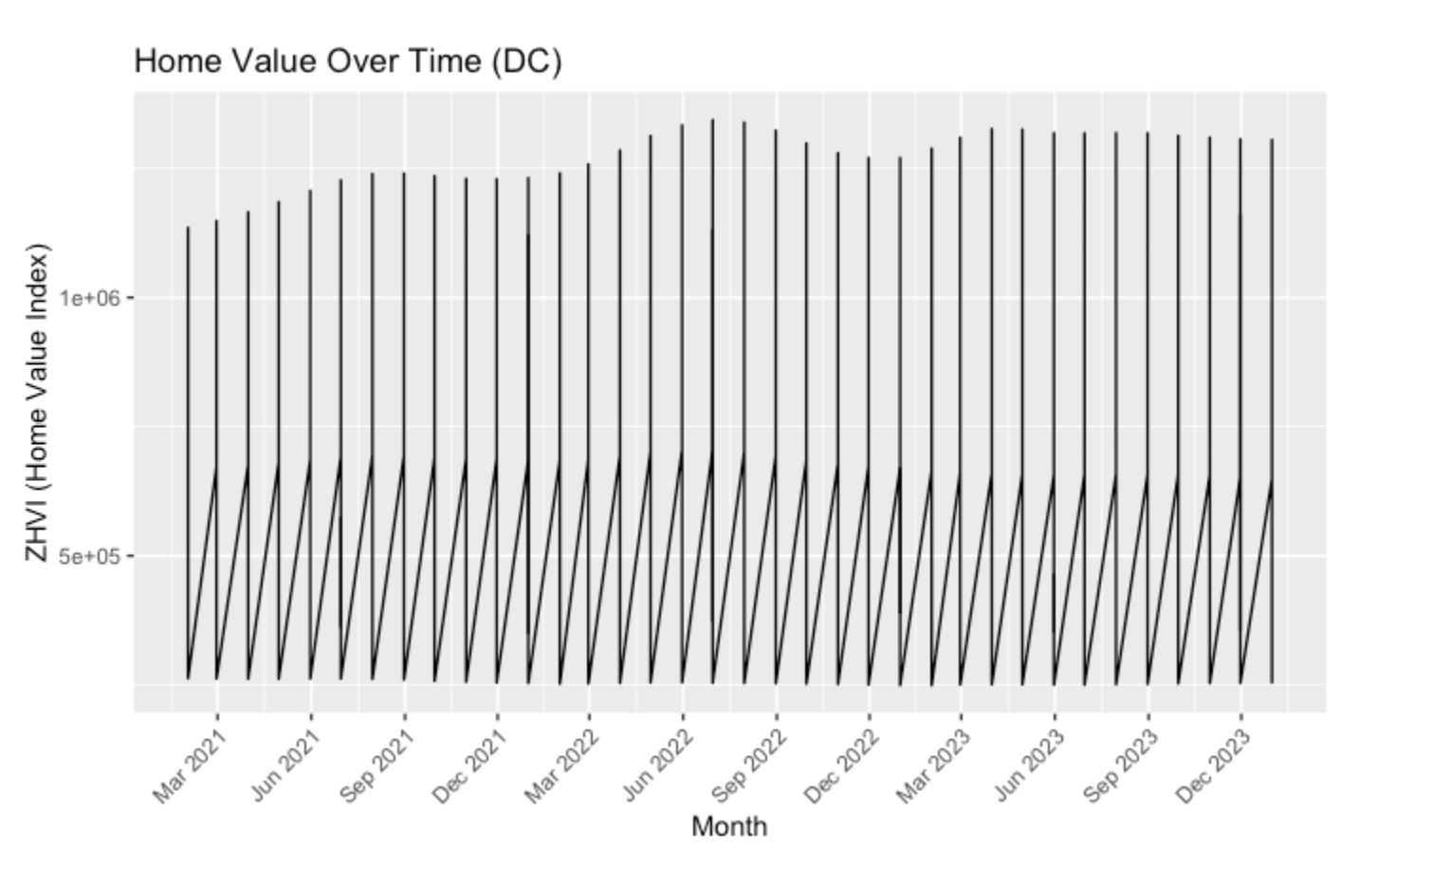
Line Graph (DC)

Slide 8
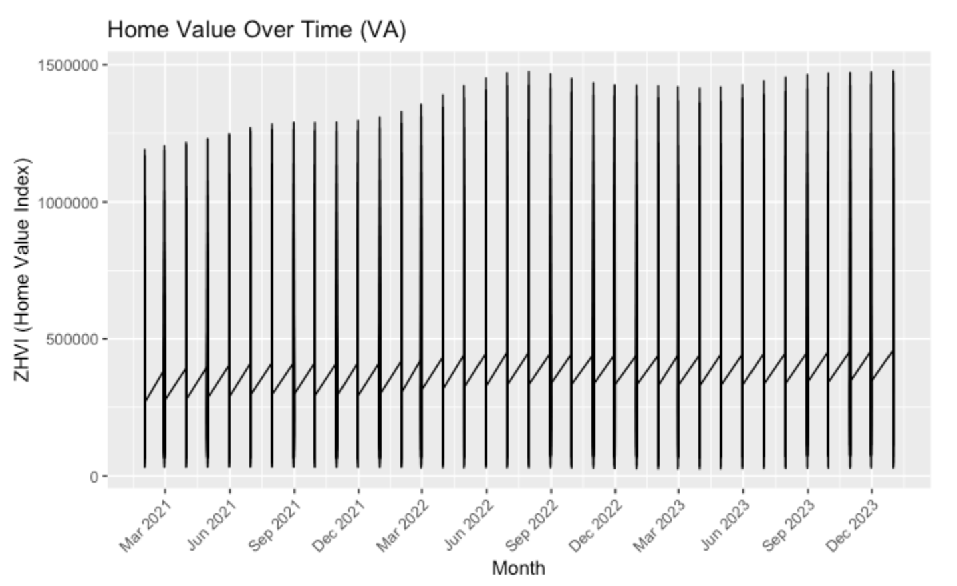
Line Graph (VA)

Slide 9
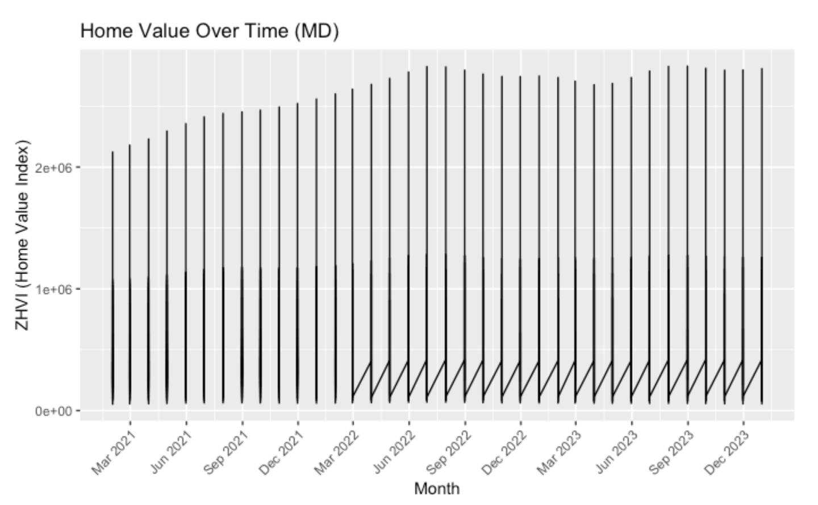
Line Graph (MD)

Slide 10
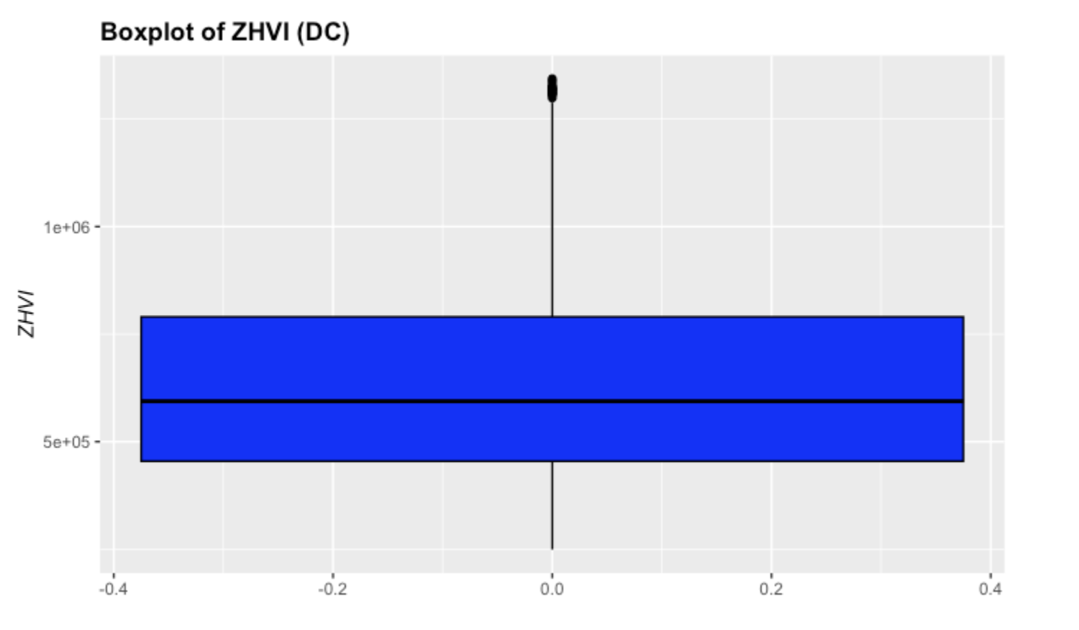
Box Plot (DC)

Slide 11
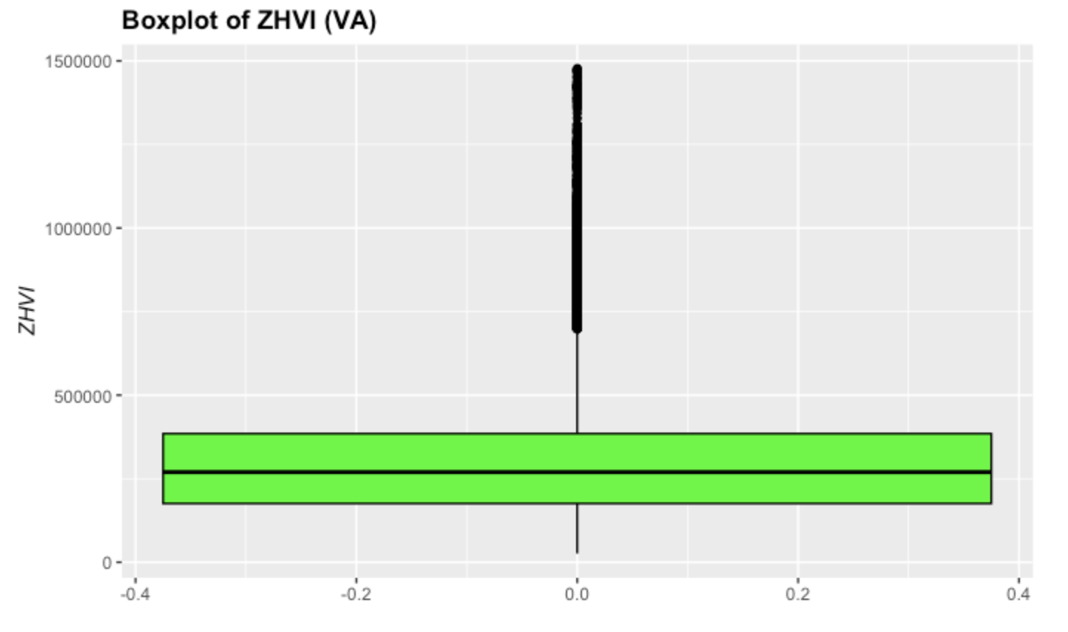
Box Plot (VA)

Slide 12
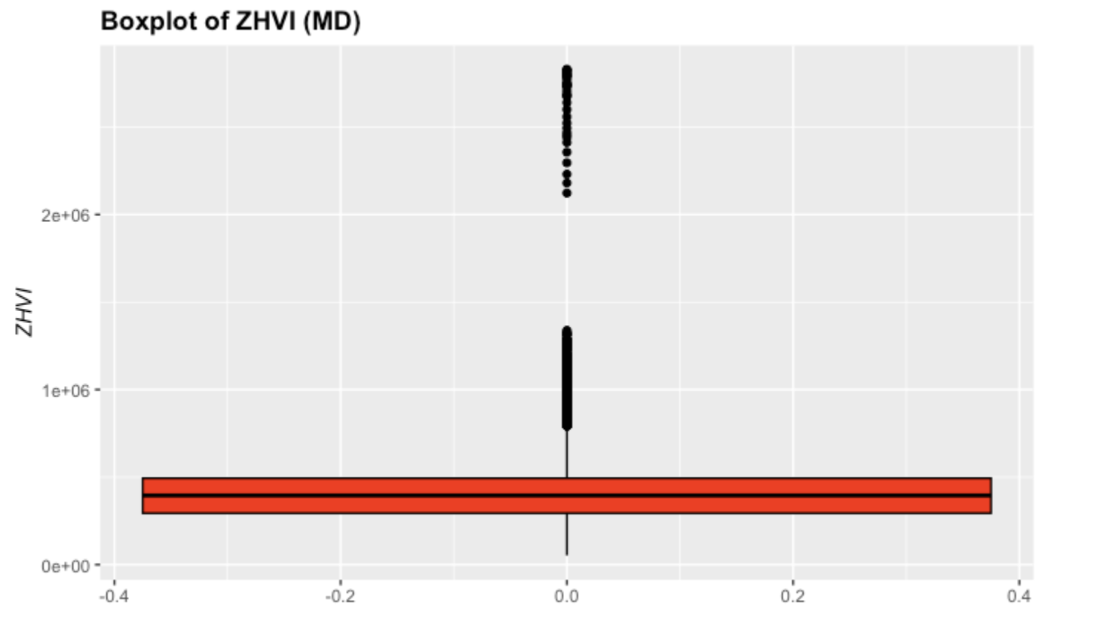
Box Plot (MD)

Slide 13
ANOVA results
We noticed p-values above 0.05 when testing avg housing prices as a whole through the 4 years between the 3 regions
Same result when testing years individually
Null hypothesis rejected (significant difference noticed)

Slide 14

Conclusions
Housing prices have steadily increased year by year in all significant areas of the DMV
ANOVA test confirmed, that the null hypothesis could not be rejected
Line graphs show a similar general trend

